Slide 1
Weekly Update #13
Gijs Admiraal

Slide 2
Recap from previous weeks
Started exploring topics: atom-by-atom generation, non-standard amino acids (nsAA), (chemical) language models, data augmentation, discrete diffusion
Finished 10-week deadline
Compare different protein sequence representations (amino acids, all-atom, etc.) in a discrete diffusion setting with a D3PM
Started setting up in the cluster
A lot of troubles with original D3PM implementation
Tried different implementation and settled on D3PM minimal

Slide 3
This week?
Fixed cluster issues:
Writing from container to staff-umbrella
GPU memory issues
Loading full wikimedia dataset
Understanding D3PM minimal code base
Architecture: Diffusion Transformer (DiT) with time step embedding
Noising: transform tokens into one of N classes (uniform)
Integrated amino acid sequences into code base

Slide 4
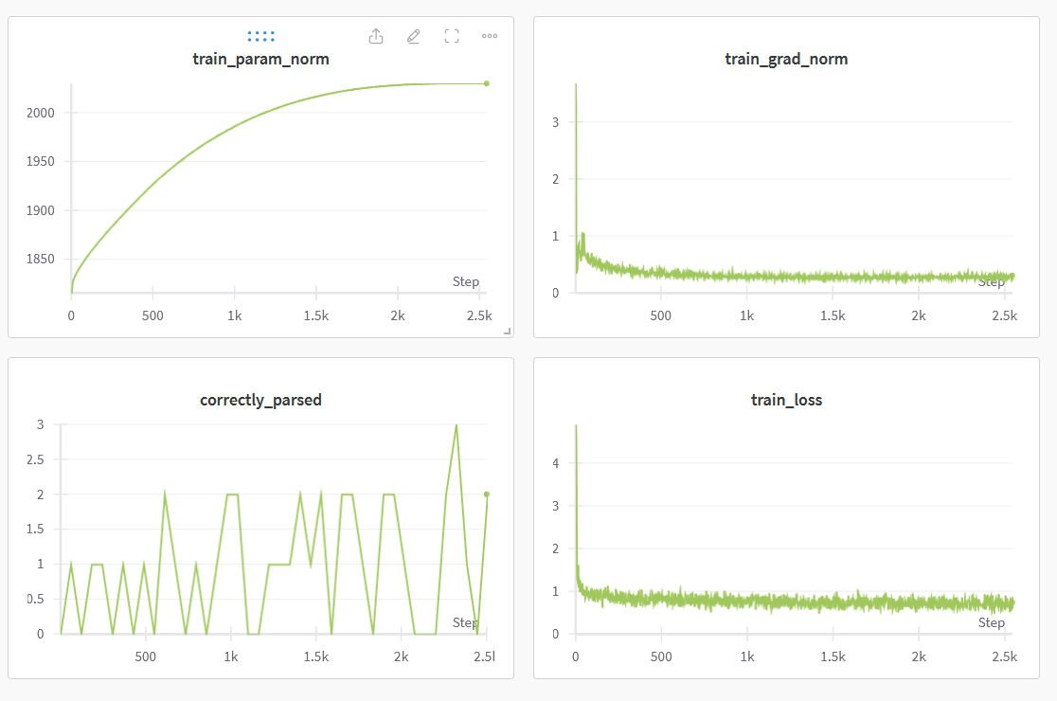
Training for 5 epochs on small text dataset

Slide 5
Waiting on some jobs
Full dataset creation
And dataset analysis
Training on amino acid sequences

Slide 6
Next week?
Start implementing masked noising process (absorbing state)
Debug incoming jobs?
Train a complete amino acid model

Slide 7
notes
In depth understanding of original paper together with code base
Model architecture etc.
Loss function
How is noising done
Data representation, analysis
What should be monitored/plotted with expected behaviour
What needs to be adapted? Model architecture, loss function, model input

